Slide 1

Mohr’s Circle
By : Group 8
Abdulrahman Mohamed Abou Fotouh | Mechatronics (Sec 1)
Ali Khalid Ali Ibrahim | Mechatronics (Sec 1)
Mohammed Mohsen Abdulrahman Mohammed | Mechatronics (Sec 2)
Mahmoud Morsy Abdullah Abdulrahman | Mechatronics (Sec 2)
Sameh Reda Mahrous Al-Sayed | Production

Slide 2

01
OUR Project (Introduction)
02
Stress Transformation
03
GUI
04
Testing
05
Flow Chart

Slide 3

OUR Project
Mohr’s circle
The Mohr circle is used to find the stress components and, i.e., coordinates of any point on the circle, acting on any other plane passing through making an angle with the plane Solution to find Principals stress

Slide 4
Why Mohr's circle?
It is important in many mechanical engineering science like metallurgy and material science and metal forming and design
eliminate engineering student efforts and help them to solve Mohr's circle problem
Help us to calculate critical stress to avoid faliure in design

Slide 5



WHAT can we calculate?
Maximum Normal Stress
Maximum Shear Stress
$$σ_{p_{1}}$$
$$τ_{max}$$
$$σ_{p_{2}}$$
Minimum Normal Stress
Avg Stress
$$σ_{Avg}$$

Slide 6
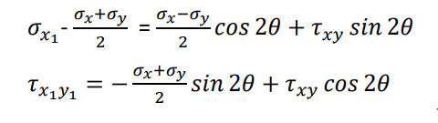
Mohr ‘s circle
Analatical solution

Slide 7
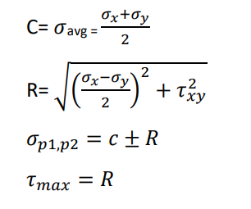
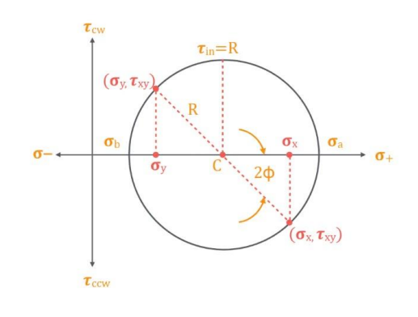
Mohr’s circle

Slide 8
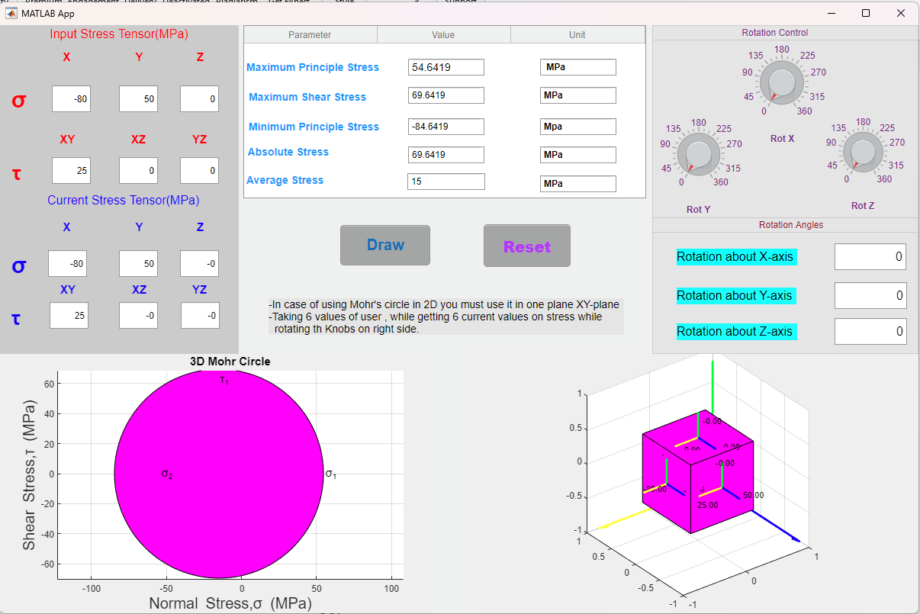
GUI

Slide 9
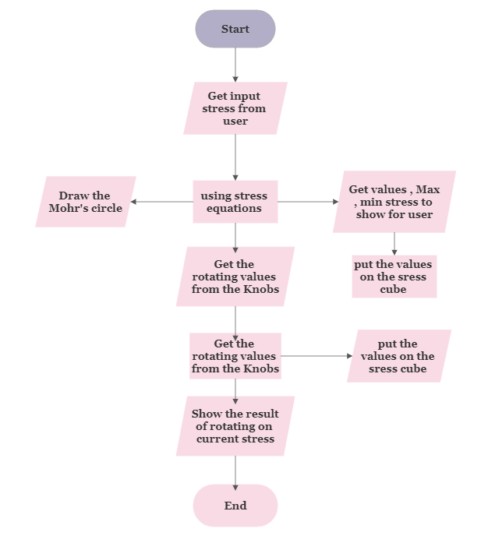
Flow chart

Slide 10
Code
there is 5 main functions in this code
“Rotate “
This function is used for rotating element in 3D in three angles, we use it for rotating the stress Cube.
“cube_3D”
this function is used for drawing a the stress cube and rotating it in the 3D while rotating vectors and variables of current stress in 3D too.
“Tensor”
this function is used to show and solve the equation of current stress tensor , and applying them on field to show them while rotating the knobs
“mohrs_3d_2d”
This function is used in calculating the values of maximum, minimum, average, absolute and drawing the Mohr’s circle in a 2D case and 3D case also with special condition of drawing 2D in XY-plan only.
“Restart”
this function is used to restart all the program to reinput the values and draw again and get outputs.

Slide 11
RESOURCES
Mechanics of Materials for Dummies by James H. Allen III
Metal forming third Edition Mechanics and Metallurgy
https://pantelisliolios.com/mohr-circle-3d/
https://byjusexamprep.com/mohrs-circle-i
https://www.roymech.co.uk/Useful_Tables/Mechanics/Mohrs_circle.html

Slide 12
THANKS!
Any Question!

